Slide 1
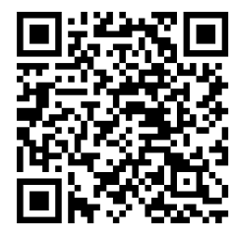
2024-2025
KINDERGARTEN REGISTRATION
Opens March 4th, 2024
Closes May 3rd, 2024
Register Online - Scan the QR Code or visit www.whrsd.org and click on the Registration icon.
Paper Registration - Print the packet from www.whrsd.org and click on the Registration icon or contact the District Registrar, Charlene Guzman at 781-618-7481, charlene.guzman@whrsd.org.
Walk-in Service and Registration Appointments - Registration service is available from March 4th, 2024 to May 3rd, 2024 from 9:00 AM to 2:00 PM Monday through Thursday. Families can drop off completed registration packets during this time.
Kindergarten Screenings - Families of registered students will be contacted
to schedule a screening appointment for the week of May 20th, 2024.

